Slide 1



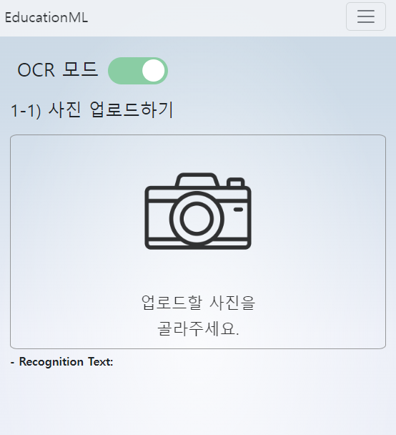
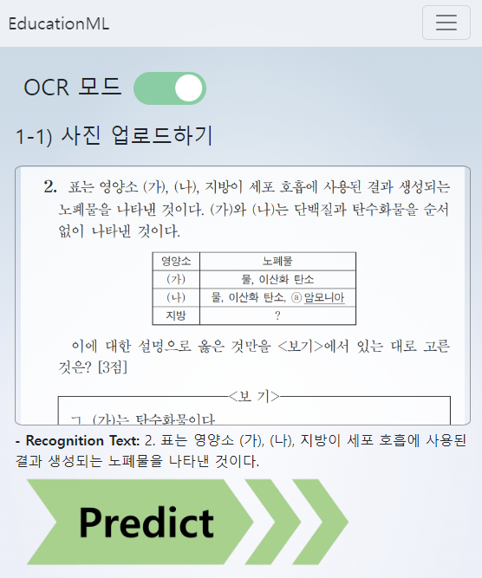
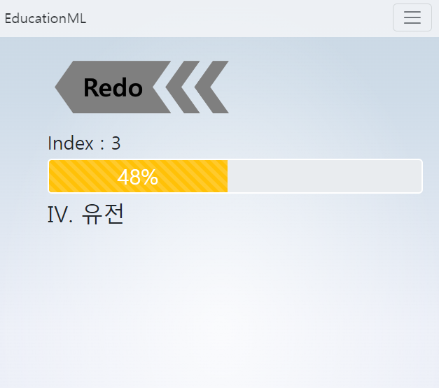
주요 서비스 단면도
[Client : 문제 업로드]
[OCR : 글자 인식]
[ML : 유형 분류]

Slide 2
[FrontEnd] - Svelte
[API] – Google Cloud
[ML/DL] – AI Model
routes
└ +pages (landing)
└ about ─ +pages
└ run ─ +pages
Data Extraction
Vertex Vision AI - API
Storage API
Event
AI Model API
Data Preprocessing
Upload Image
Google OCR Model
(Vertex Vision AI)
- Tokenizer
- Keras
Prediction
[BackEnd] – Firebase
Prediction
UI
- Index
- Probability
Firebase Storage
Notes:
{img}

Slide 3
[FrontEnd] - Svelte
[API] – Google Cloud
[ML/DL] – AI Model
routes
└ run ─ +pages
Data Extraction
Storage API
AI Model API
Event
Data Preprocessing
Google OCR
(Vertex Vision AI)
Upload Image
- Tokenizer
- Keras
Prediction
[BackEnd] – Firebase
Prediction
UI
Firebase Functions
- Index
- Probability
- Authentication
- Storage
Notes:
{img}

